Slide 1
Class 11: Classification 2
MGSC 310
Ben Labaschin

Slide 2
Class 11: Outline
Generating predictions in Logistic Models
Confusion Matrices
ROC Curves and AUC
Lab 11

Slide 3
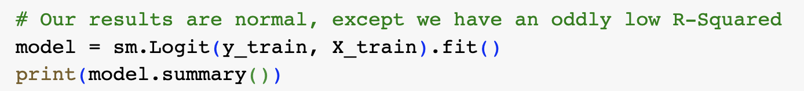
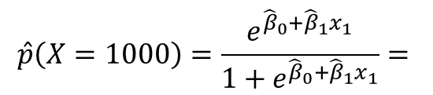
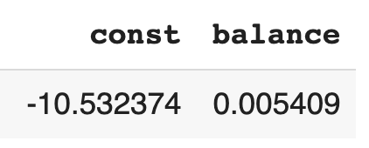
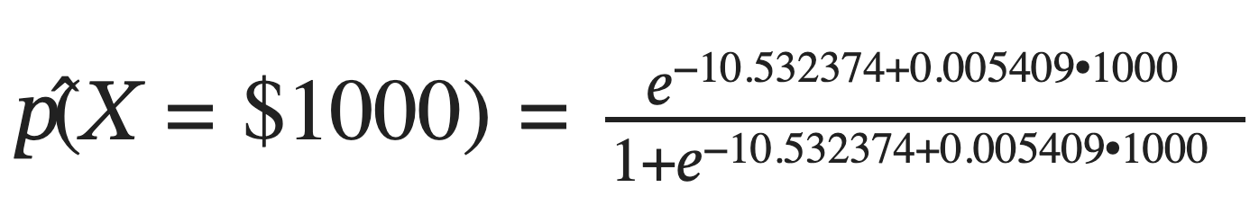
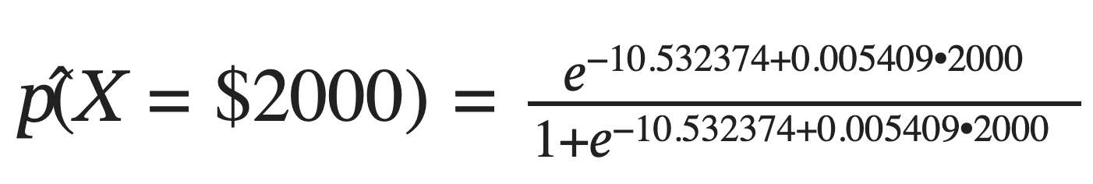
Generating Predicted Probabilities from a Logit Model
To generate predictions, we use the estimated coefficients in the logit equation
The estimated probability of default with a balance of $1,000 is given by
The estimated probability of default with a balance of $2,000 is given by

Slide 4
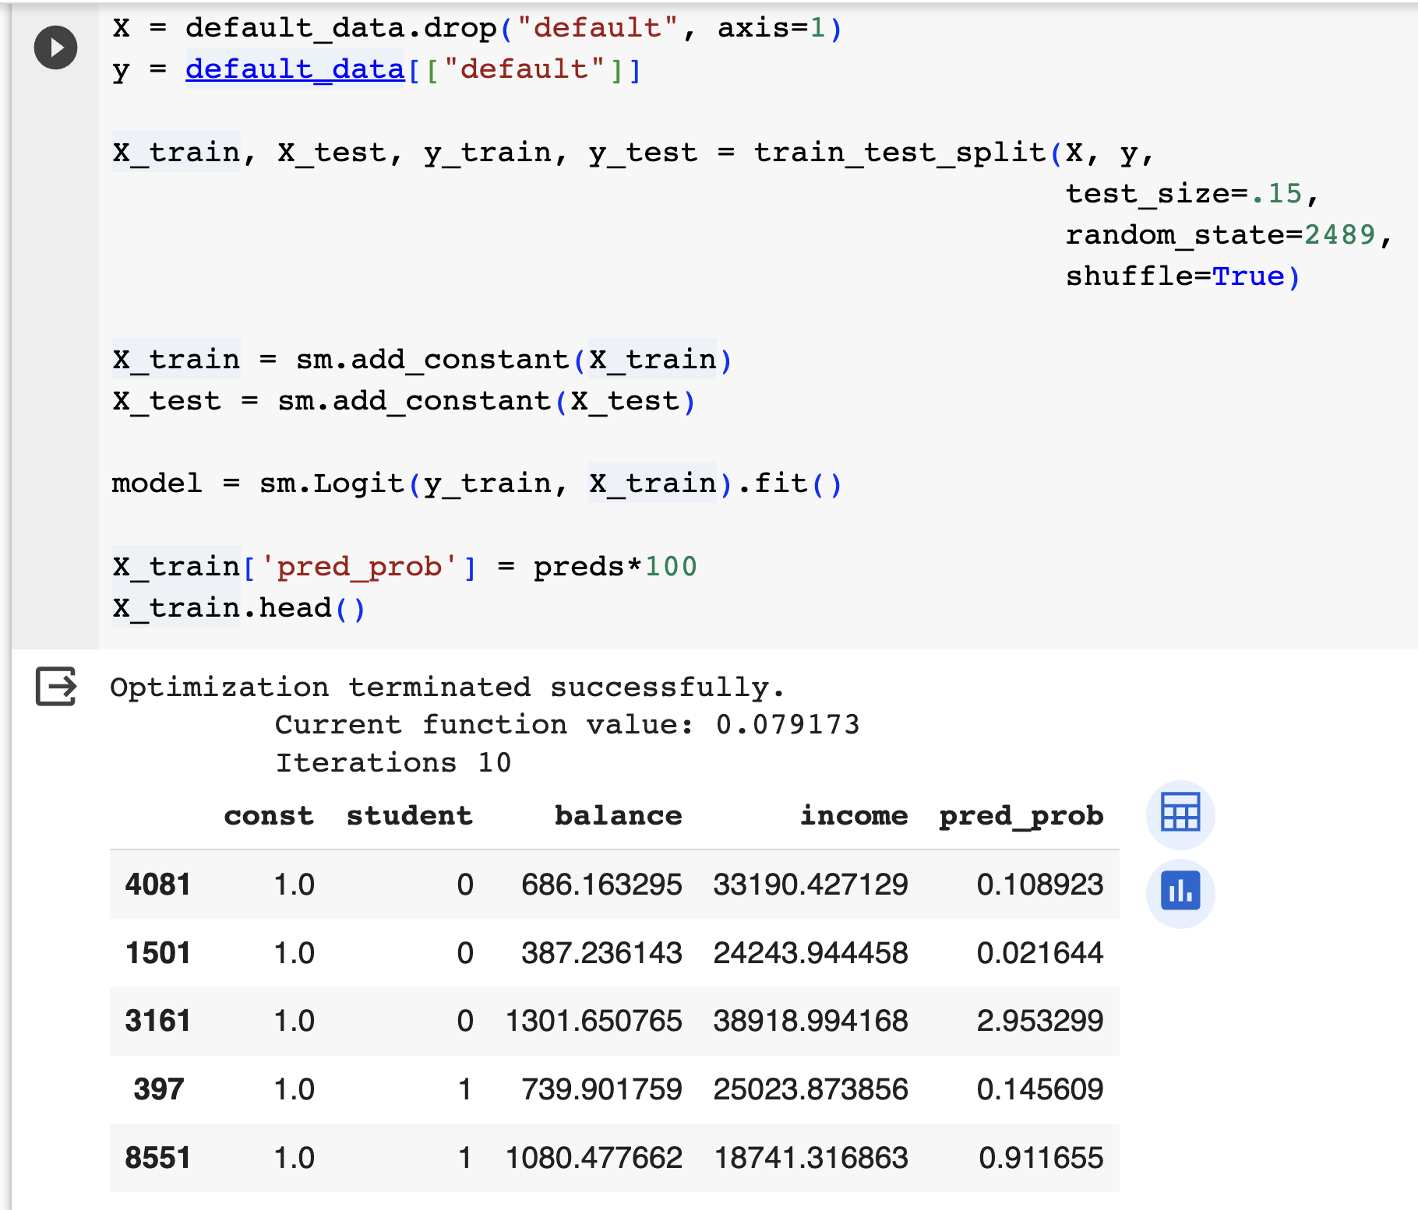

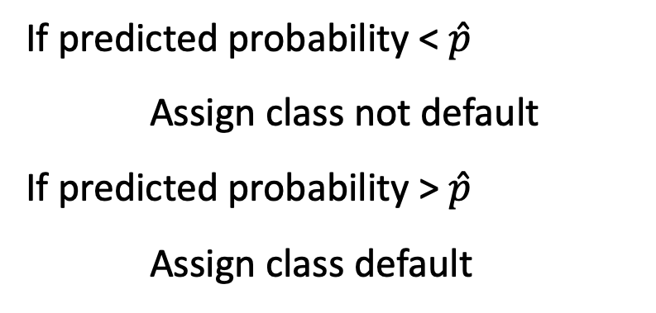
From Predicted Probabilities to Class Predictions

Slide 5
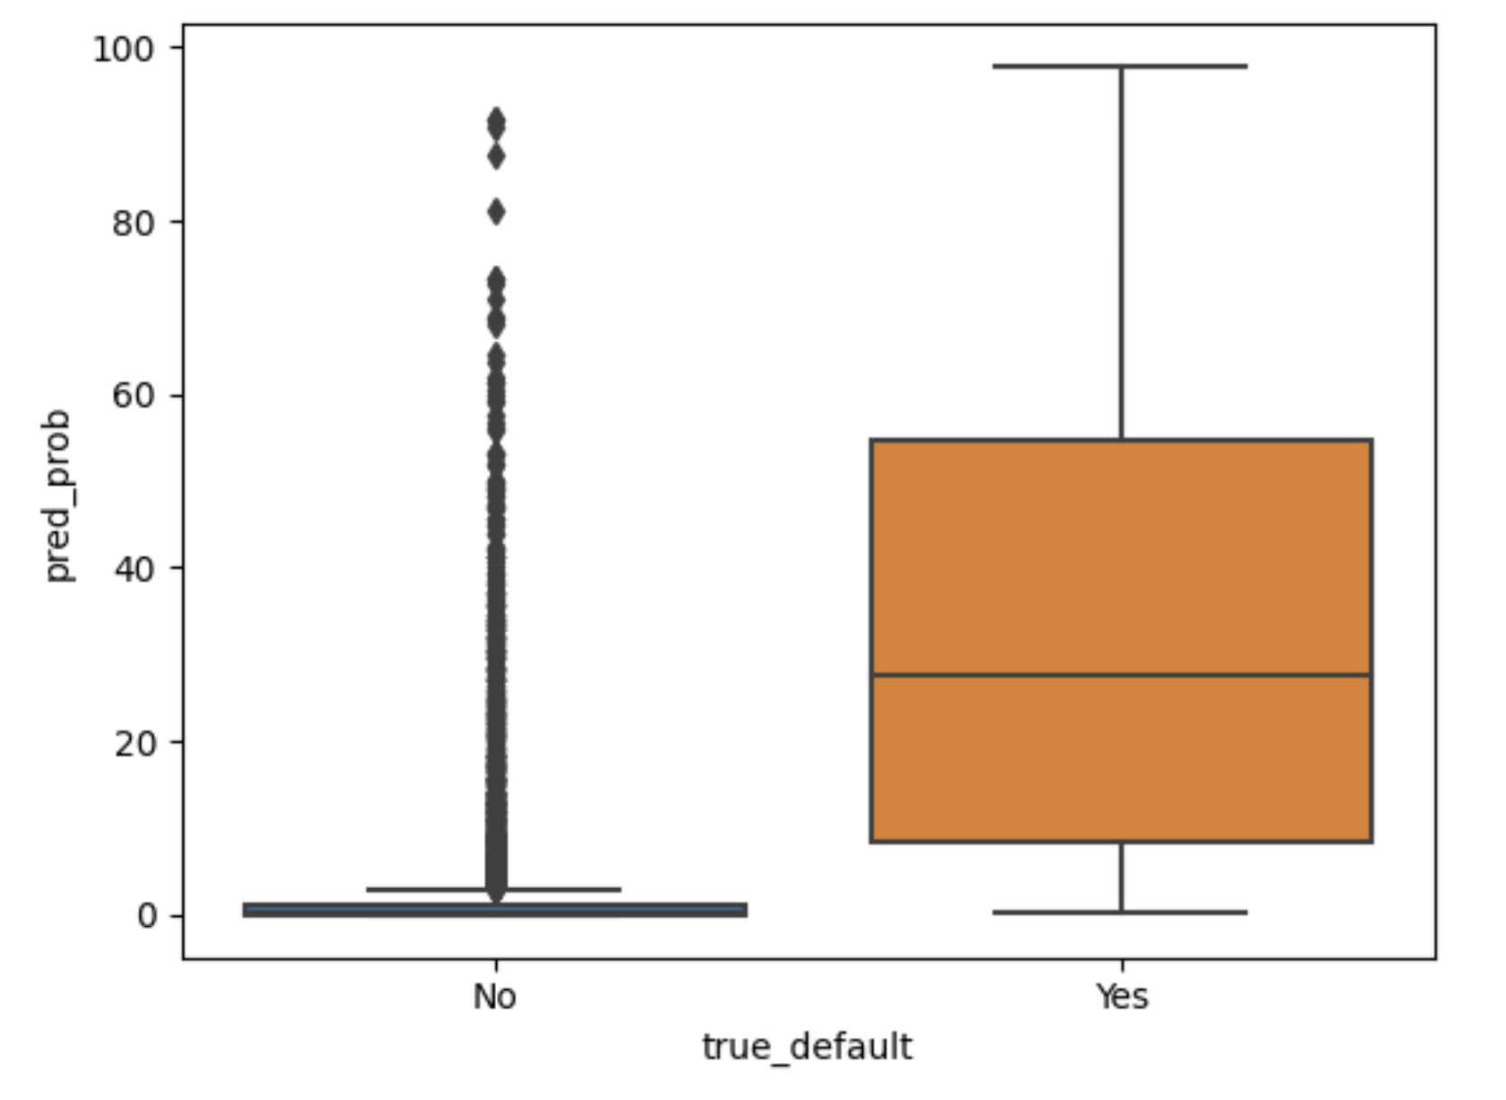
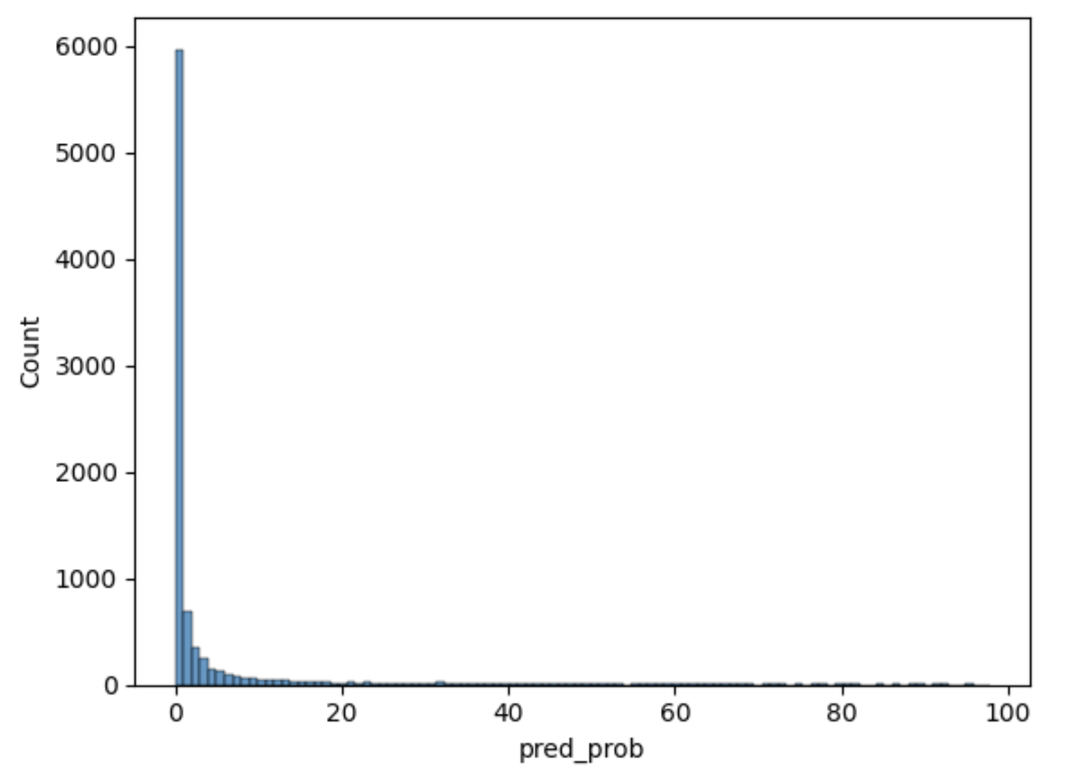
What Do We Do With Scores or Estimated Probabilities?
Okay, so we have probabilities, what then?
Note there is almost always some overlap between the probabilities of the classes
We (often) can’t choose a probability such that above this all actual defaulters are correctly identified, and below this all non-defaulter are identified
So we will (almost) always have some false positives and false negatives

Slide 6
Confusion Matrix: Table of False/True Positives and False/True Negatives
 |  | True default status
 |  | No | Yes
Predicted default status | No | True negative (TN) | False Negative (FN)
 | Yes | False Positive (FP) | True Positive (TP)

Slide 7
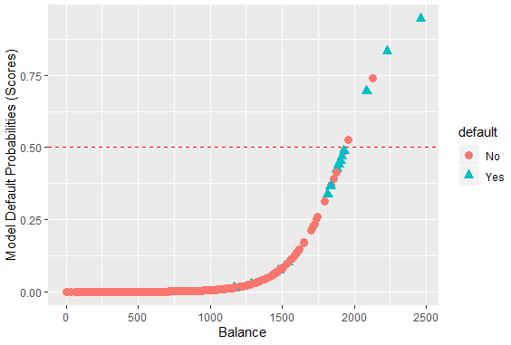

Above this line, observations are classified as defaulting
Below this line, observations classified as not defaulting
Actual default = teal triangles
If we choose a probability cutoff of 0.5, then we see we have 2 false positives and 11 FN
Note I’m working with a 5% sample of the dataset to make the numbers easier

Slide 8
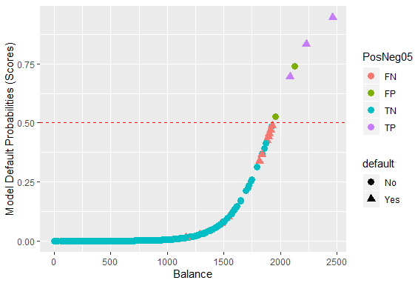
If we choose a probability cutoff of 0.5, then we see we have 2 false positives and 11 FN

Slide 9
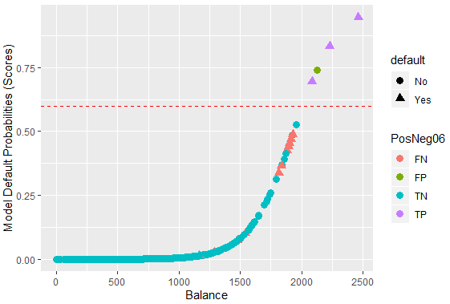

Raising the cutoff to 0.6, then we see we have 1 false positives and 11 FN

Slide 10
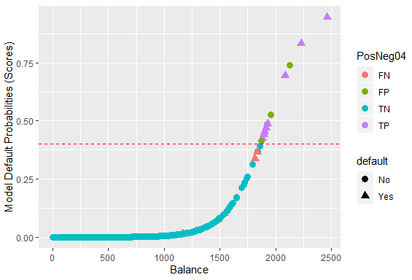

Lowering the cutoff to 0.4 results in more FPs (4) but fewer FNs (6)

Slide 11
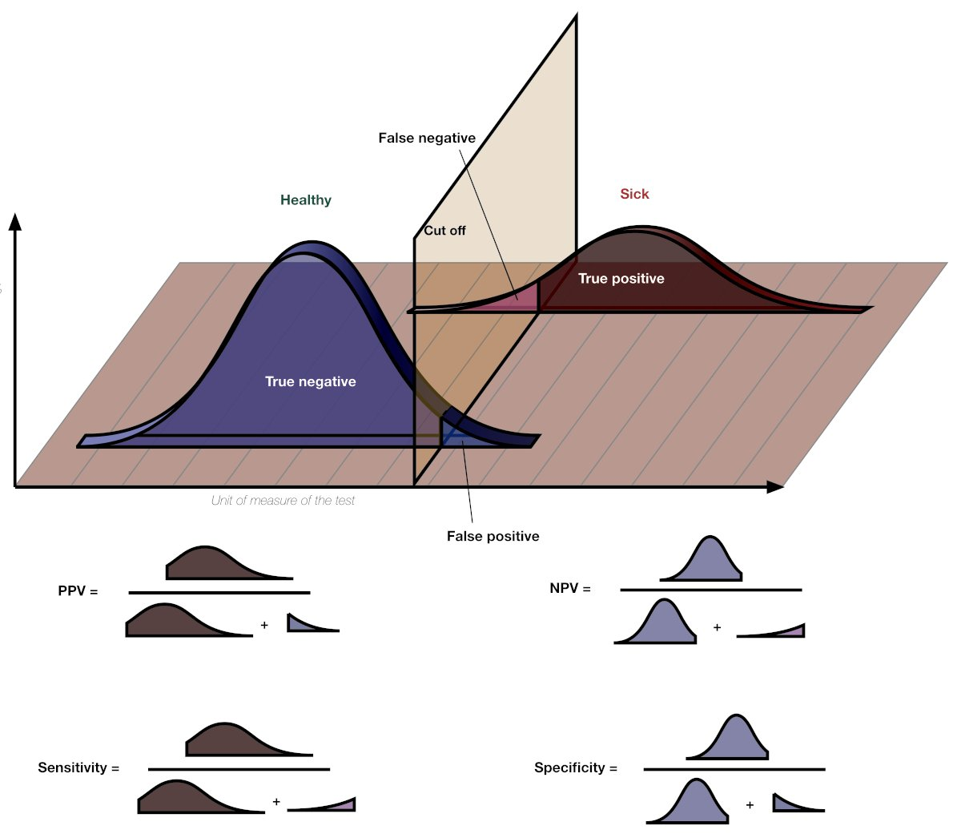
Tradeoff of False Negatives and False Positives
Precision = Predictive Positive
Value
Negative Predictive
Value
True Positive Rate = Recall =
True Negative =
Rate

Slide 12
Which Probability Cutoff To Use?
Threshold A
Threshold you choose should depend on relative costs of FPs and FN
e.g. screening at airport (cost of false neg high)
e.g. direct mail advertisement (cost of false positive low)
Some common choices
Maximize Accuracy (equal weighting of FPs and FNs)
Threshold p_hat > 0.5
Minimize cost: TC = costFP *FPs + costFN * FNs
True
Not Default
True Default
-
+
Threshold B
True
Not Default
True Default
Model Probabilities

Slide 13
Sensitivity and Specificity, Confusion Matrix at P Cutoff > 0.5
 |  | True default status
 |  | No | Yes
Predicted default status (cutoff p>0.5) | No | TN = 484 | FN = 11
 | Yes | FP = 2 | TP = 3
 |  | N = 486 | P = 14
Sensitivity: True positive rate (aka 1 – power or recall)
TP/P = 3 / 14 = 21.4%
Specificity: True negative rate
TN/N = 484 / 486= 99.5%
False positive rate (aka Type I error, 1 - Specificity)
FP/N = 2/486= 0.004%

Slide 14
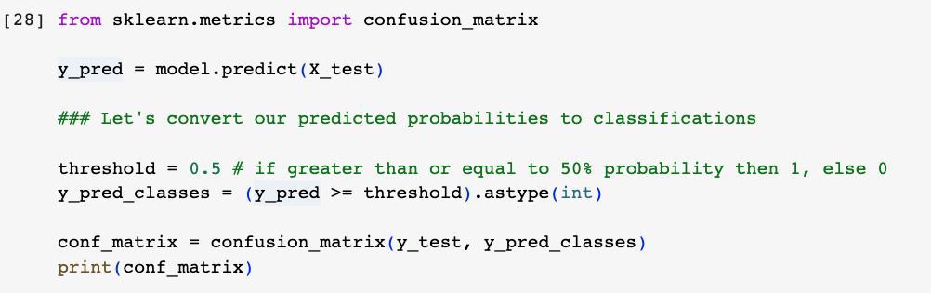
Generating Confusion Matrices in Python
To produce a confusion matrix in Python we use scikit-learn
The function confusion_matrix() produces confusion matrices but we must classify our data ahead of time
Actual event values
Our classified probabilities
To the code!
This example data frame shows how we need to structure our results data frame

Slide 15
Continuous Cutoff: ROC Curve
Cutoff p>0.01
100%
Can we show consequences of FPs and FNs as we vary the cutoff probability to assign classes?
Idea of a ROC (Receiver Operator Curve) plot
If model is no better than chance on this line
True positive
rate
Cutoff p>0.4
Cutoff p>0.5
Cutoff | TPR | FPR
0.01 | 100% | 22.6%
0.4 | 57% | 0.008
0.5 | 21.4% | 0.004%
0.6 | 21.4% | 0.002%
False Positive Rate
100%

Slide 16
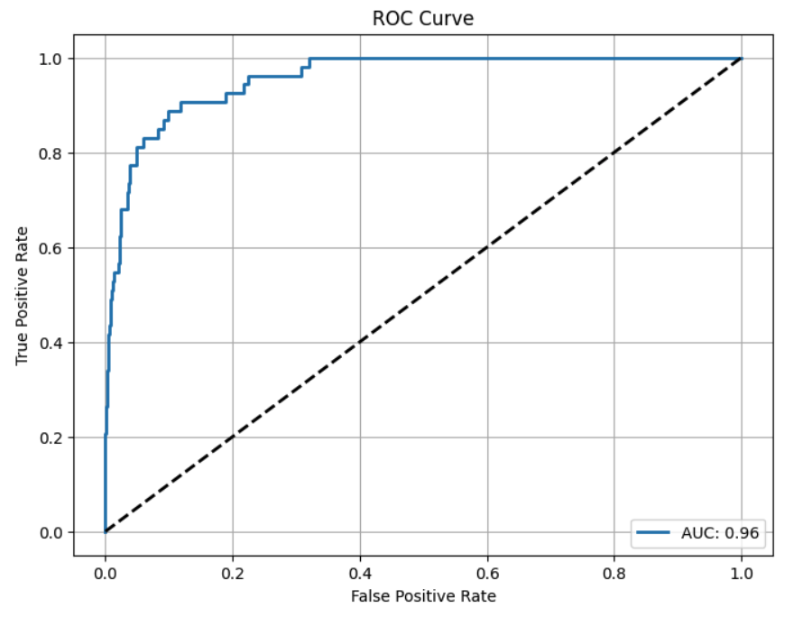
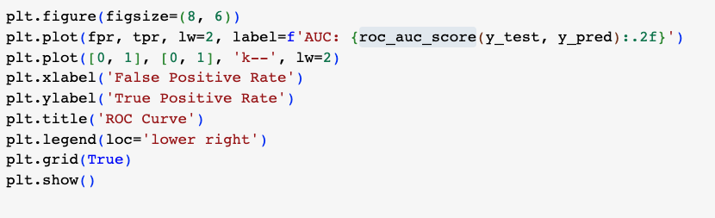
ROC Curves in Python
At a cutoff of 0.018 we get a true positive fraction of 0.5 and a false positive fraction of a very low number
Better models lie up and to the left in the ROC plot
AUC calculates how much total area is under a particular curve
AUC of 0.96 is great!

Slide 17
Class 11 Summary
Logit functions compress predictions to lie between 0 and 1, which are valid probabilities
The logistic model models the outcome (Y) as the log odds ratio!
Confusion matrices show the true/false positives/negatives.
ROC plots measure the consequence on true positive fraction and false positive fraction for different cutoff probabilities
Higher AUC scores mean a better ROC plot indicating a better model

